Slide 1
MACHINE OPTIMIZATION TECHNOLOGY
www.caroneng.com

Slide 2
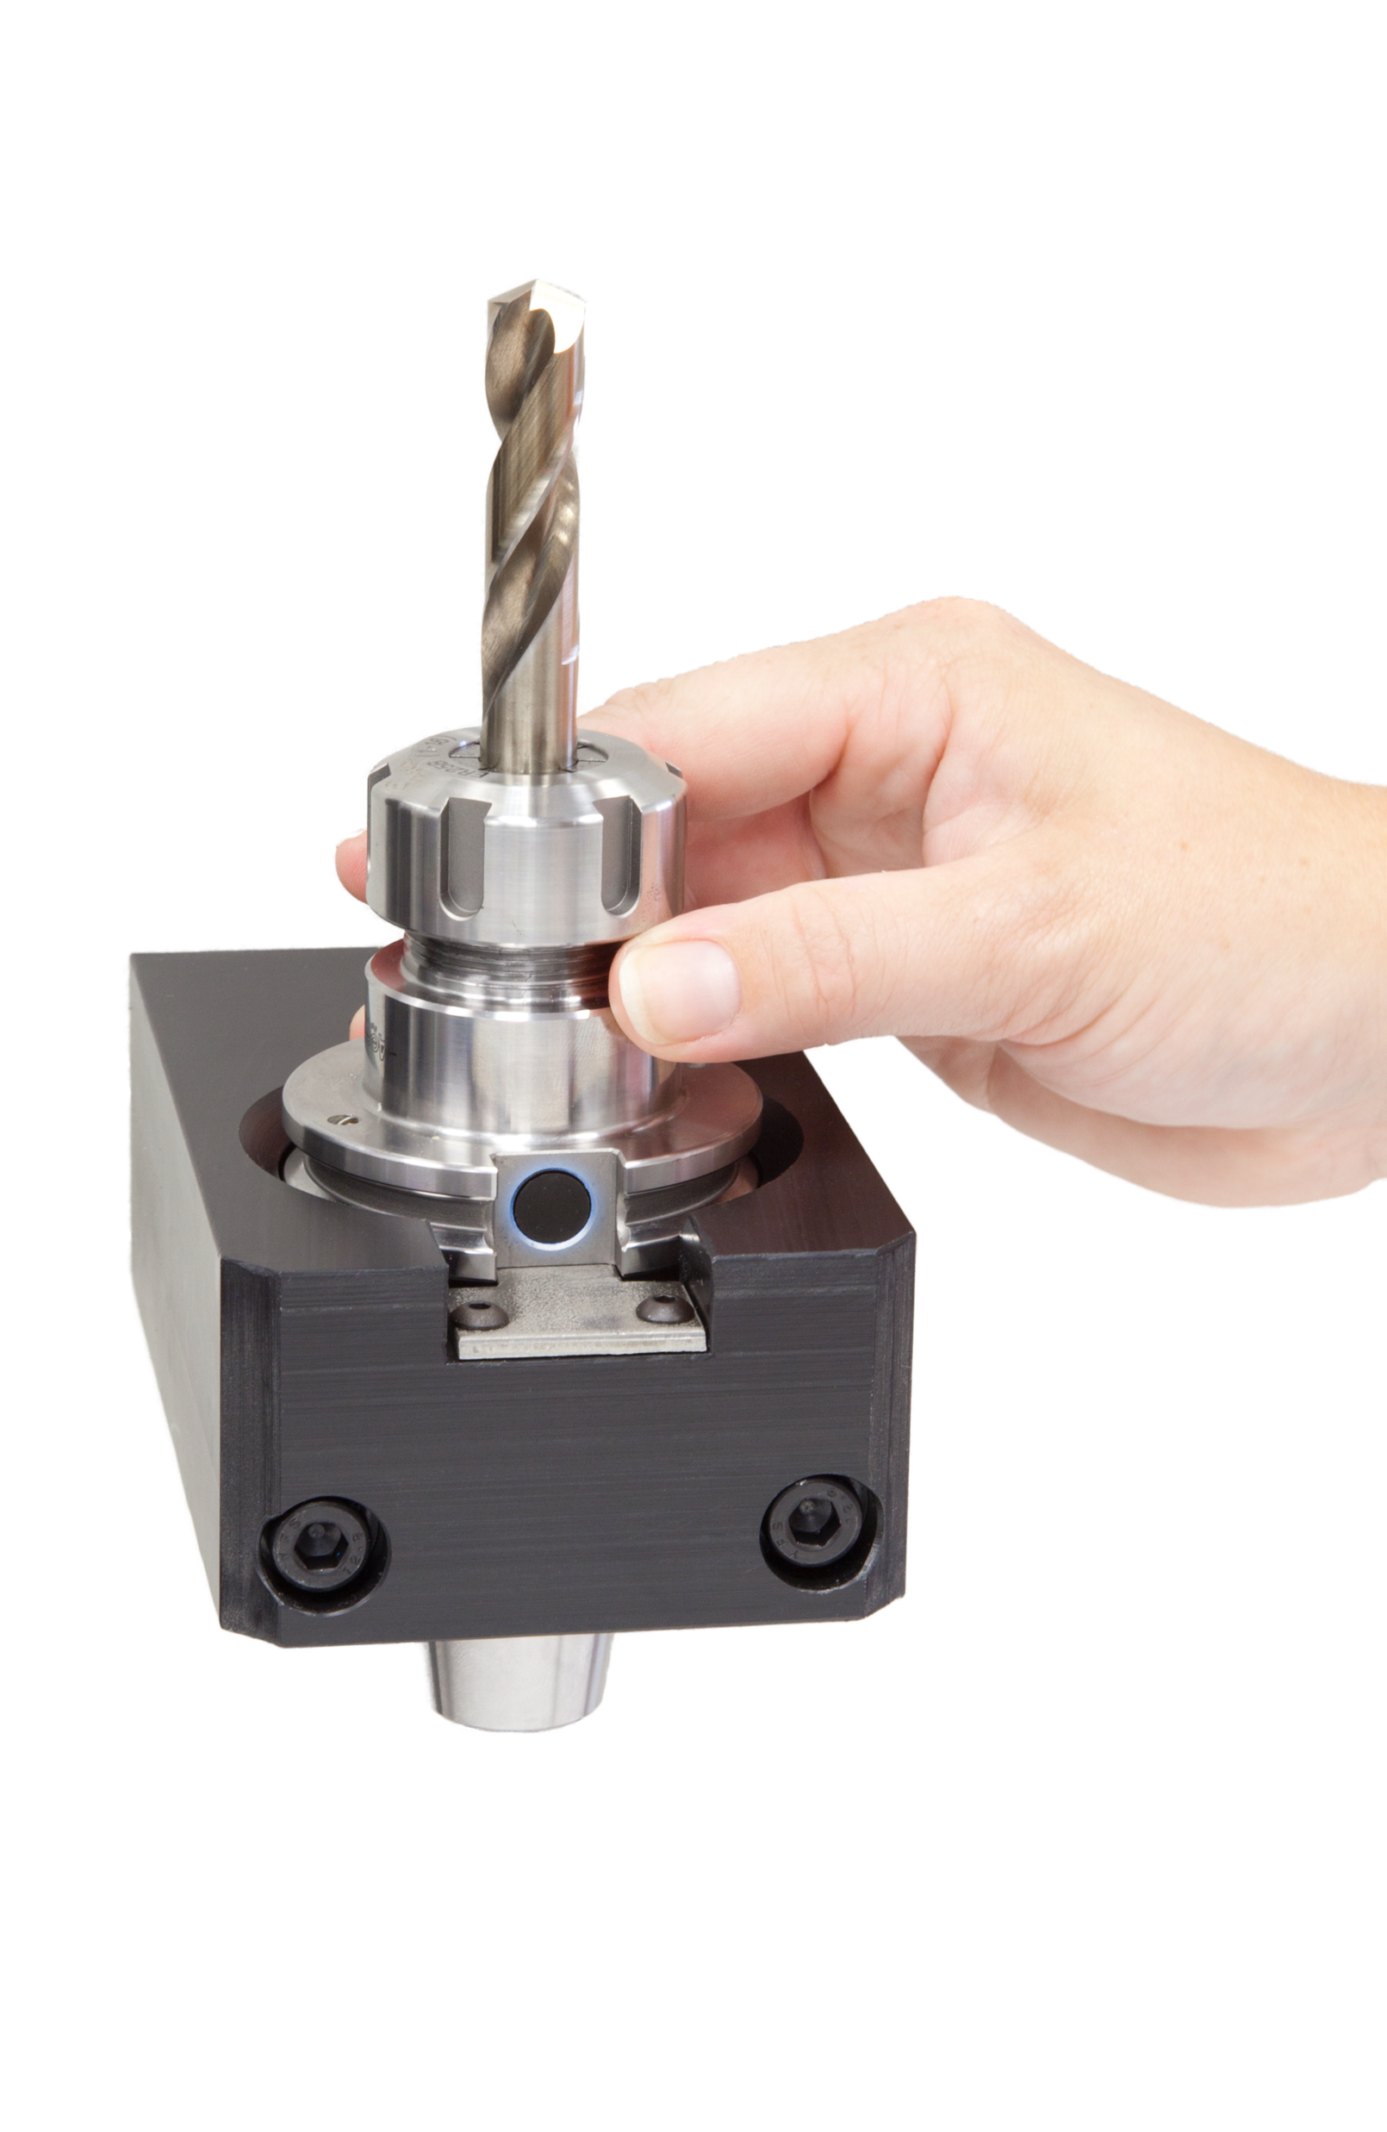
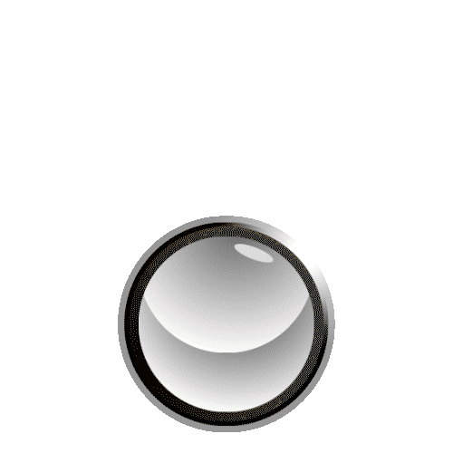
RFID Tool Management and Identification System
Improving productivity and eliminating human errors on the shop floor

Slide 3
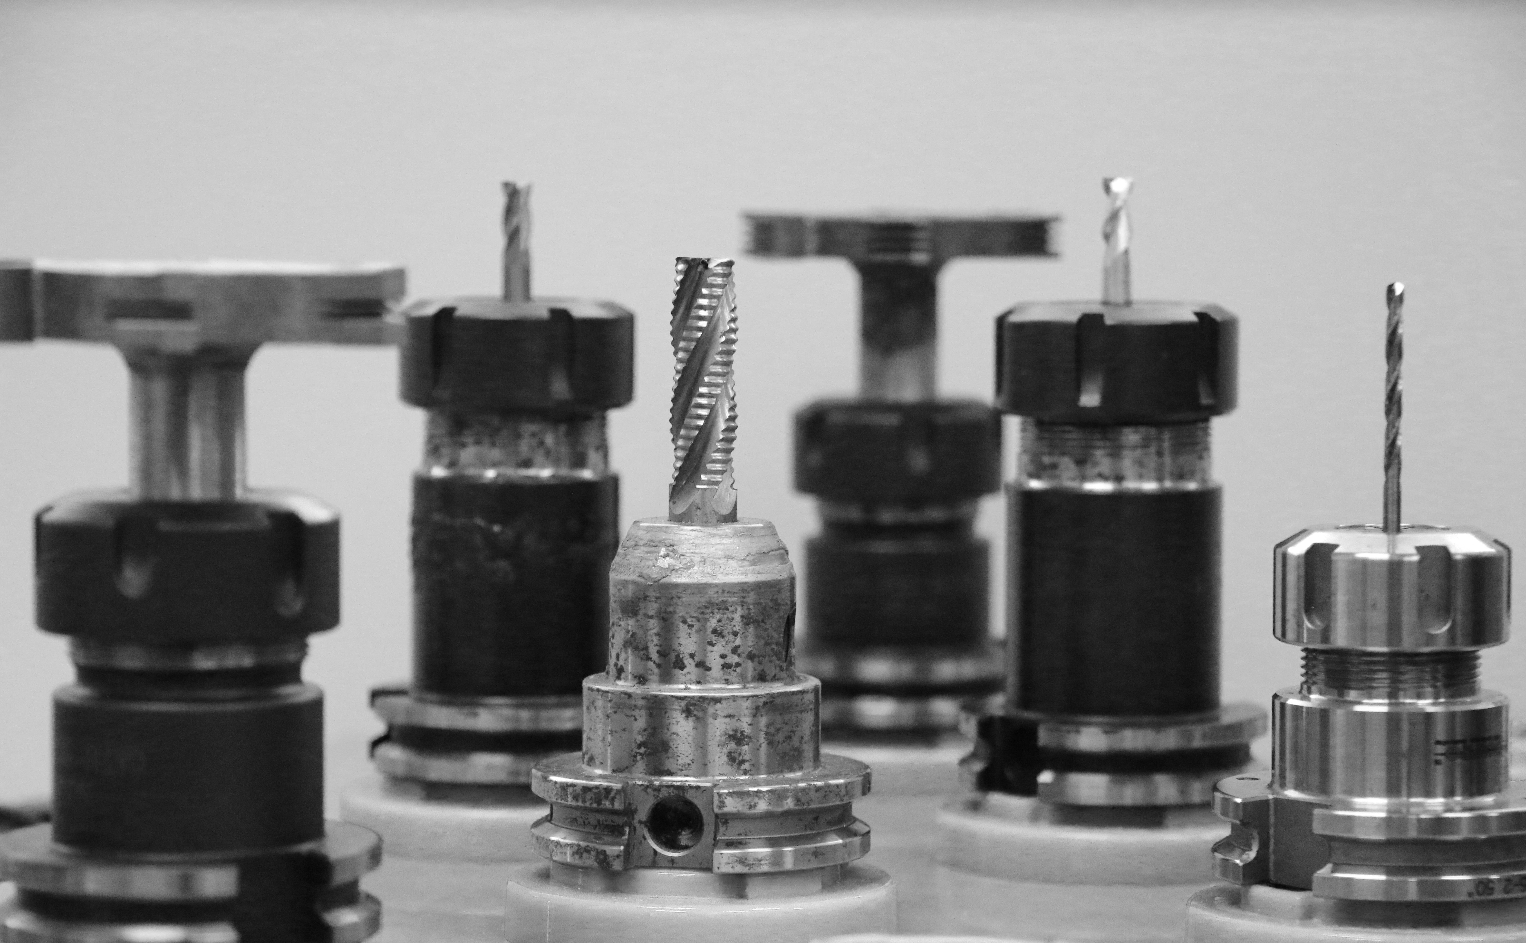
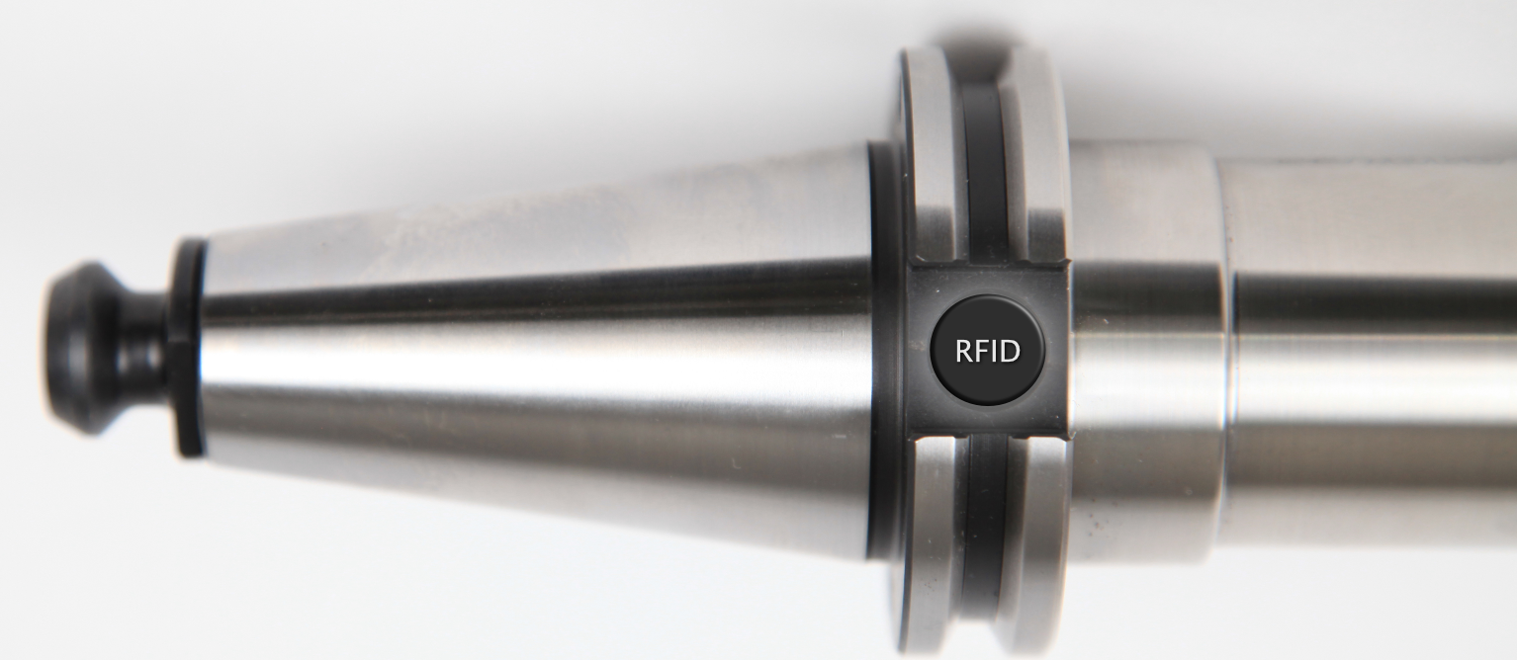
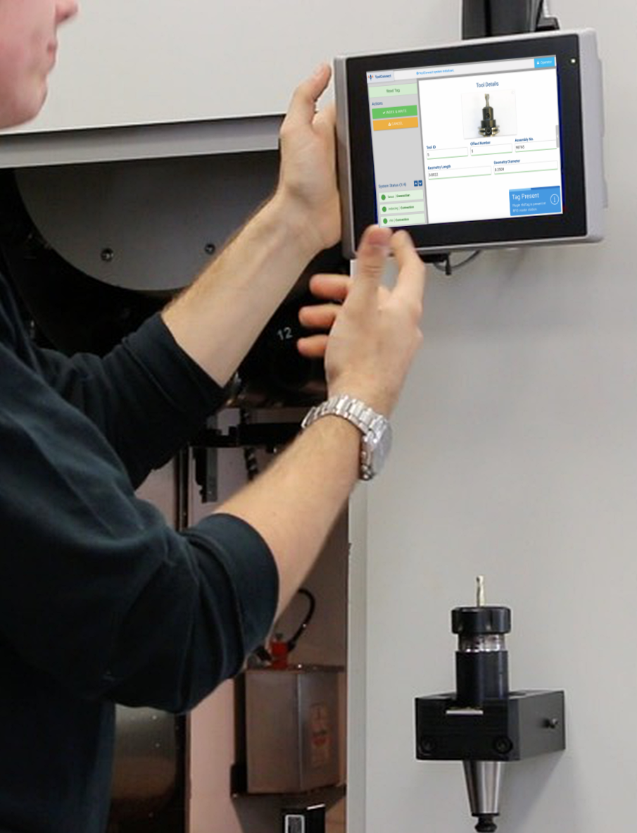
Automates the transfer of tool presetter data from RFID tags in tool holders to a machine control
RFID
Simplifies the general process of loading
tools in and out of CNC Machines
This retrofit system can be configured for an existing tool ID format or set up for any custom designed format
Validates tools. If a tool ever makes its way to the wrong machine, it will be flagged.

Slide 4
Tool Load Procedure
Machine Info
Control
Info
Tool Magazine Design
Customer Required Data
(Input & Output)
Customized to fit your needs!
Every ToolConnect System is uniquely configured to meet the customer’s RFID tool management requirements.
CUSTOM
SYSTEM
www.caroneng.com

Slide 5
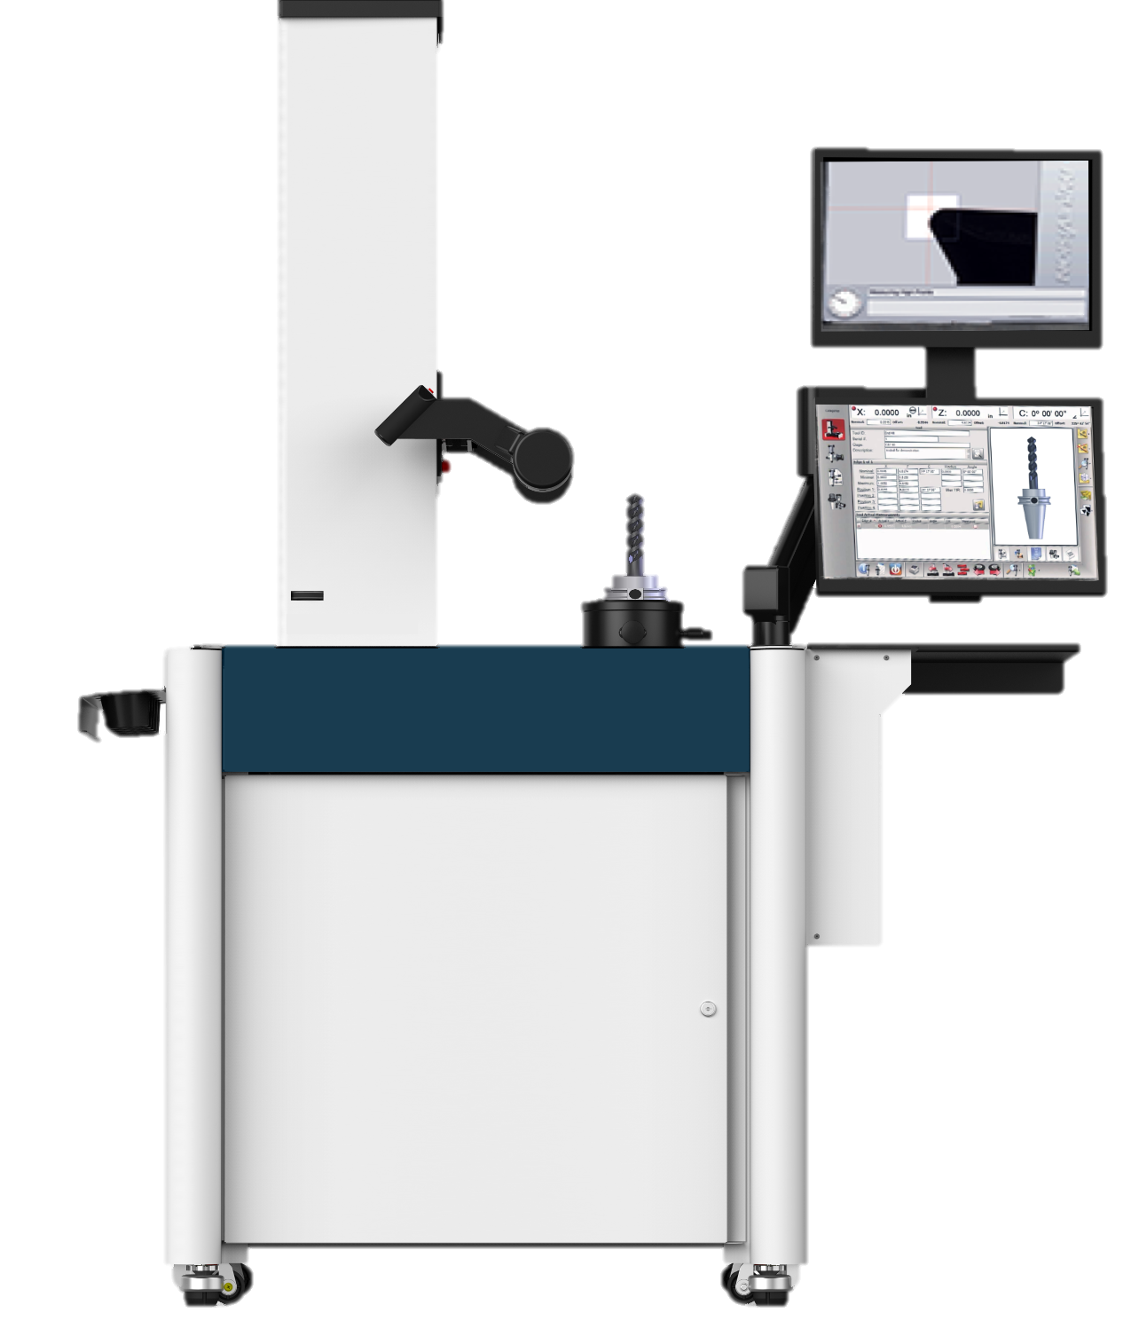
How does it work?
Step #1
Implement a
Tool Presetter
www.caroneng.com
www.caroneng.com

Slide 6
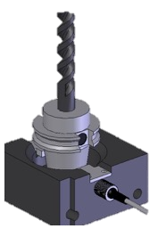
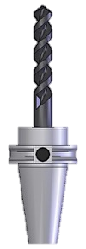
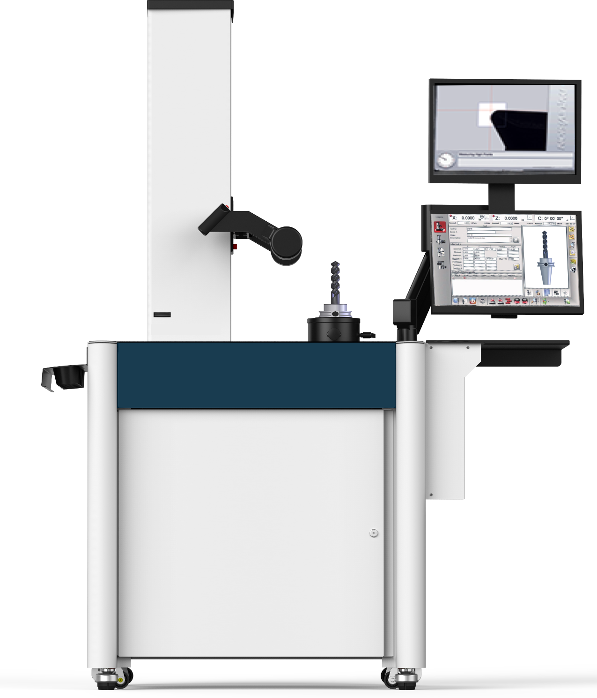
How does it work?
The Tool Presetter measures the tool and writes data to RFID Tag
PULL STUD TYPE
LENGTH
MAX RPM
WEIGHT
TOOL TOO LARGE
DIAMETER
DIAMETER
LENGTH
WEIGHT
NOSE RADIUS
NOSE RADIUS
TOOL TOO LARGE
ADAPTER TYPE
MAX RPM
ADAPTER TYPE
PULL STUD TYPE
The tool is placed in a custom read station at the machine where the data is read by ToolConnect, and written to the CNC control
This data is stored on the RFID Tag and can be read anywhere
www.caroneng.com

Slide 7
After machining is complete…
TOOL WEAR
OFFSETS
NUMBER OF TOOL CHANGES
TOOL LIFE
ToolConnect tracks tools removed and updates tool life information to the RFID tag.
www.caroneng.com

Slide 8
Data is updated back to the tool presetter to track tool life and wear data over time.
NUMBER OF TOOL CHANGES
TOOL WEAR
OFFSETS
TOOL LIFE
www.caroneng.com

Slide 9
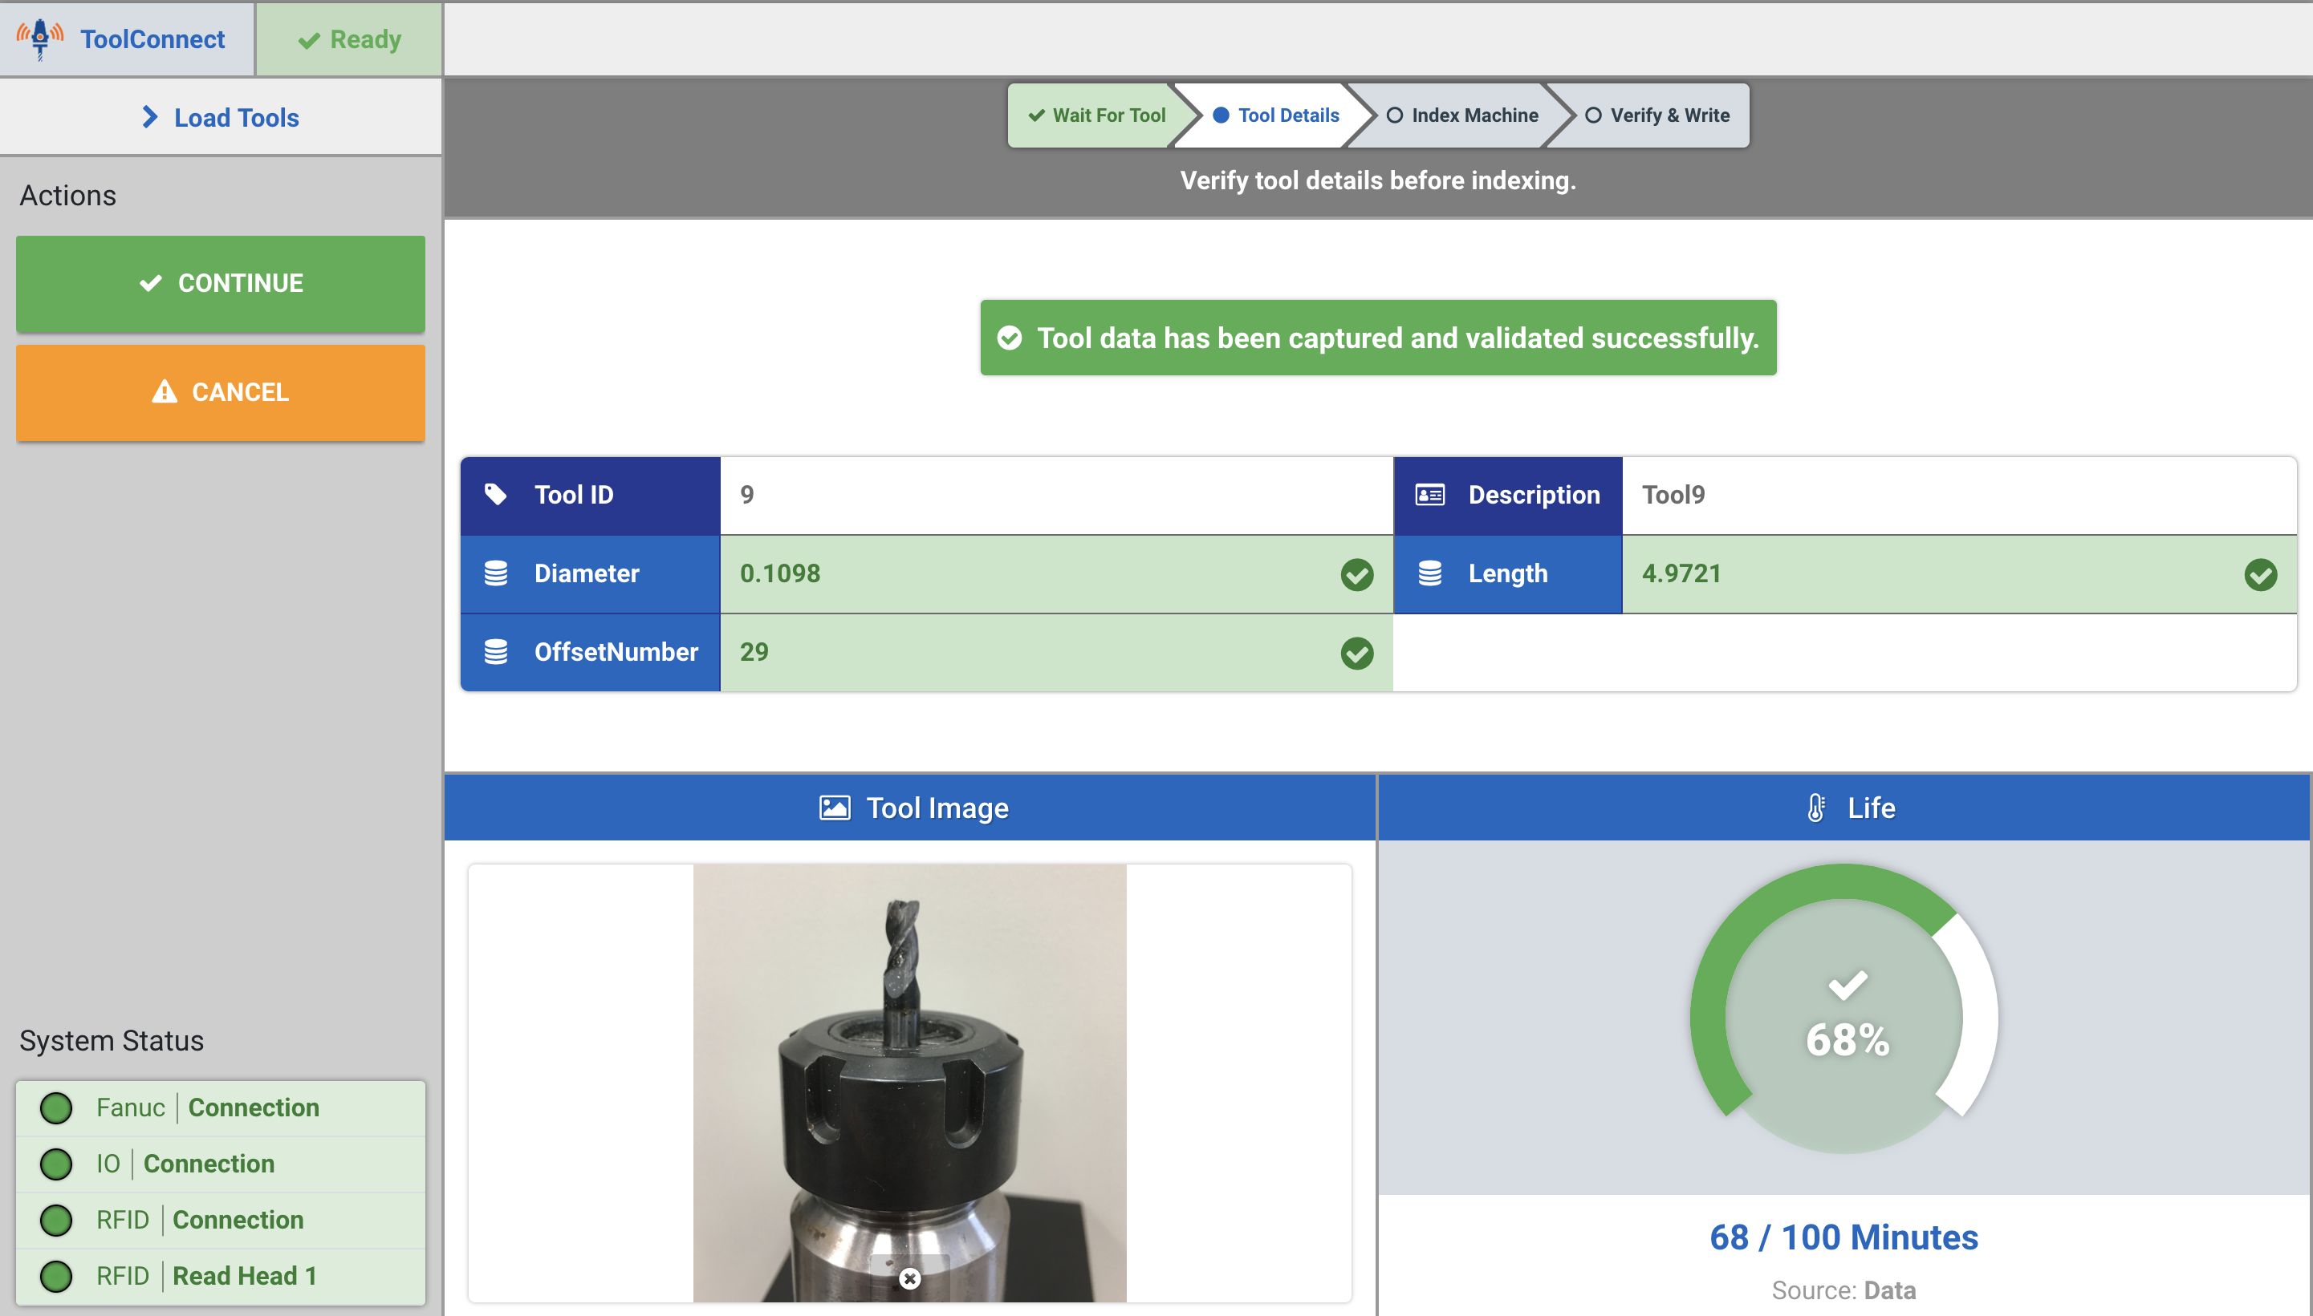
USER INTERFACE
This simple user interface allows the operator to view all tool and process info:
Tool Picture
(if image is available)
Tool ID and Description
Tool Geometry Data
System Status
Select ATC Location
Other User-Defined Custom Features
www.caroneng.com

Slide 10
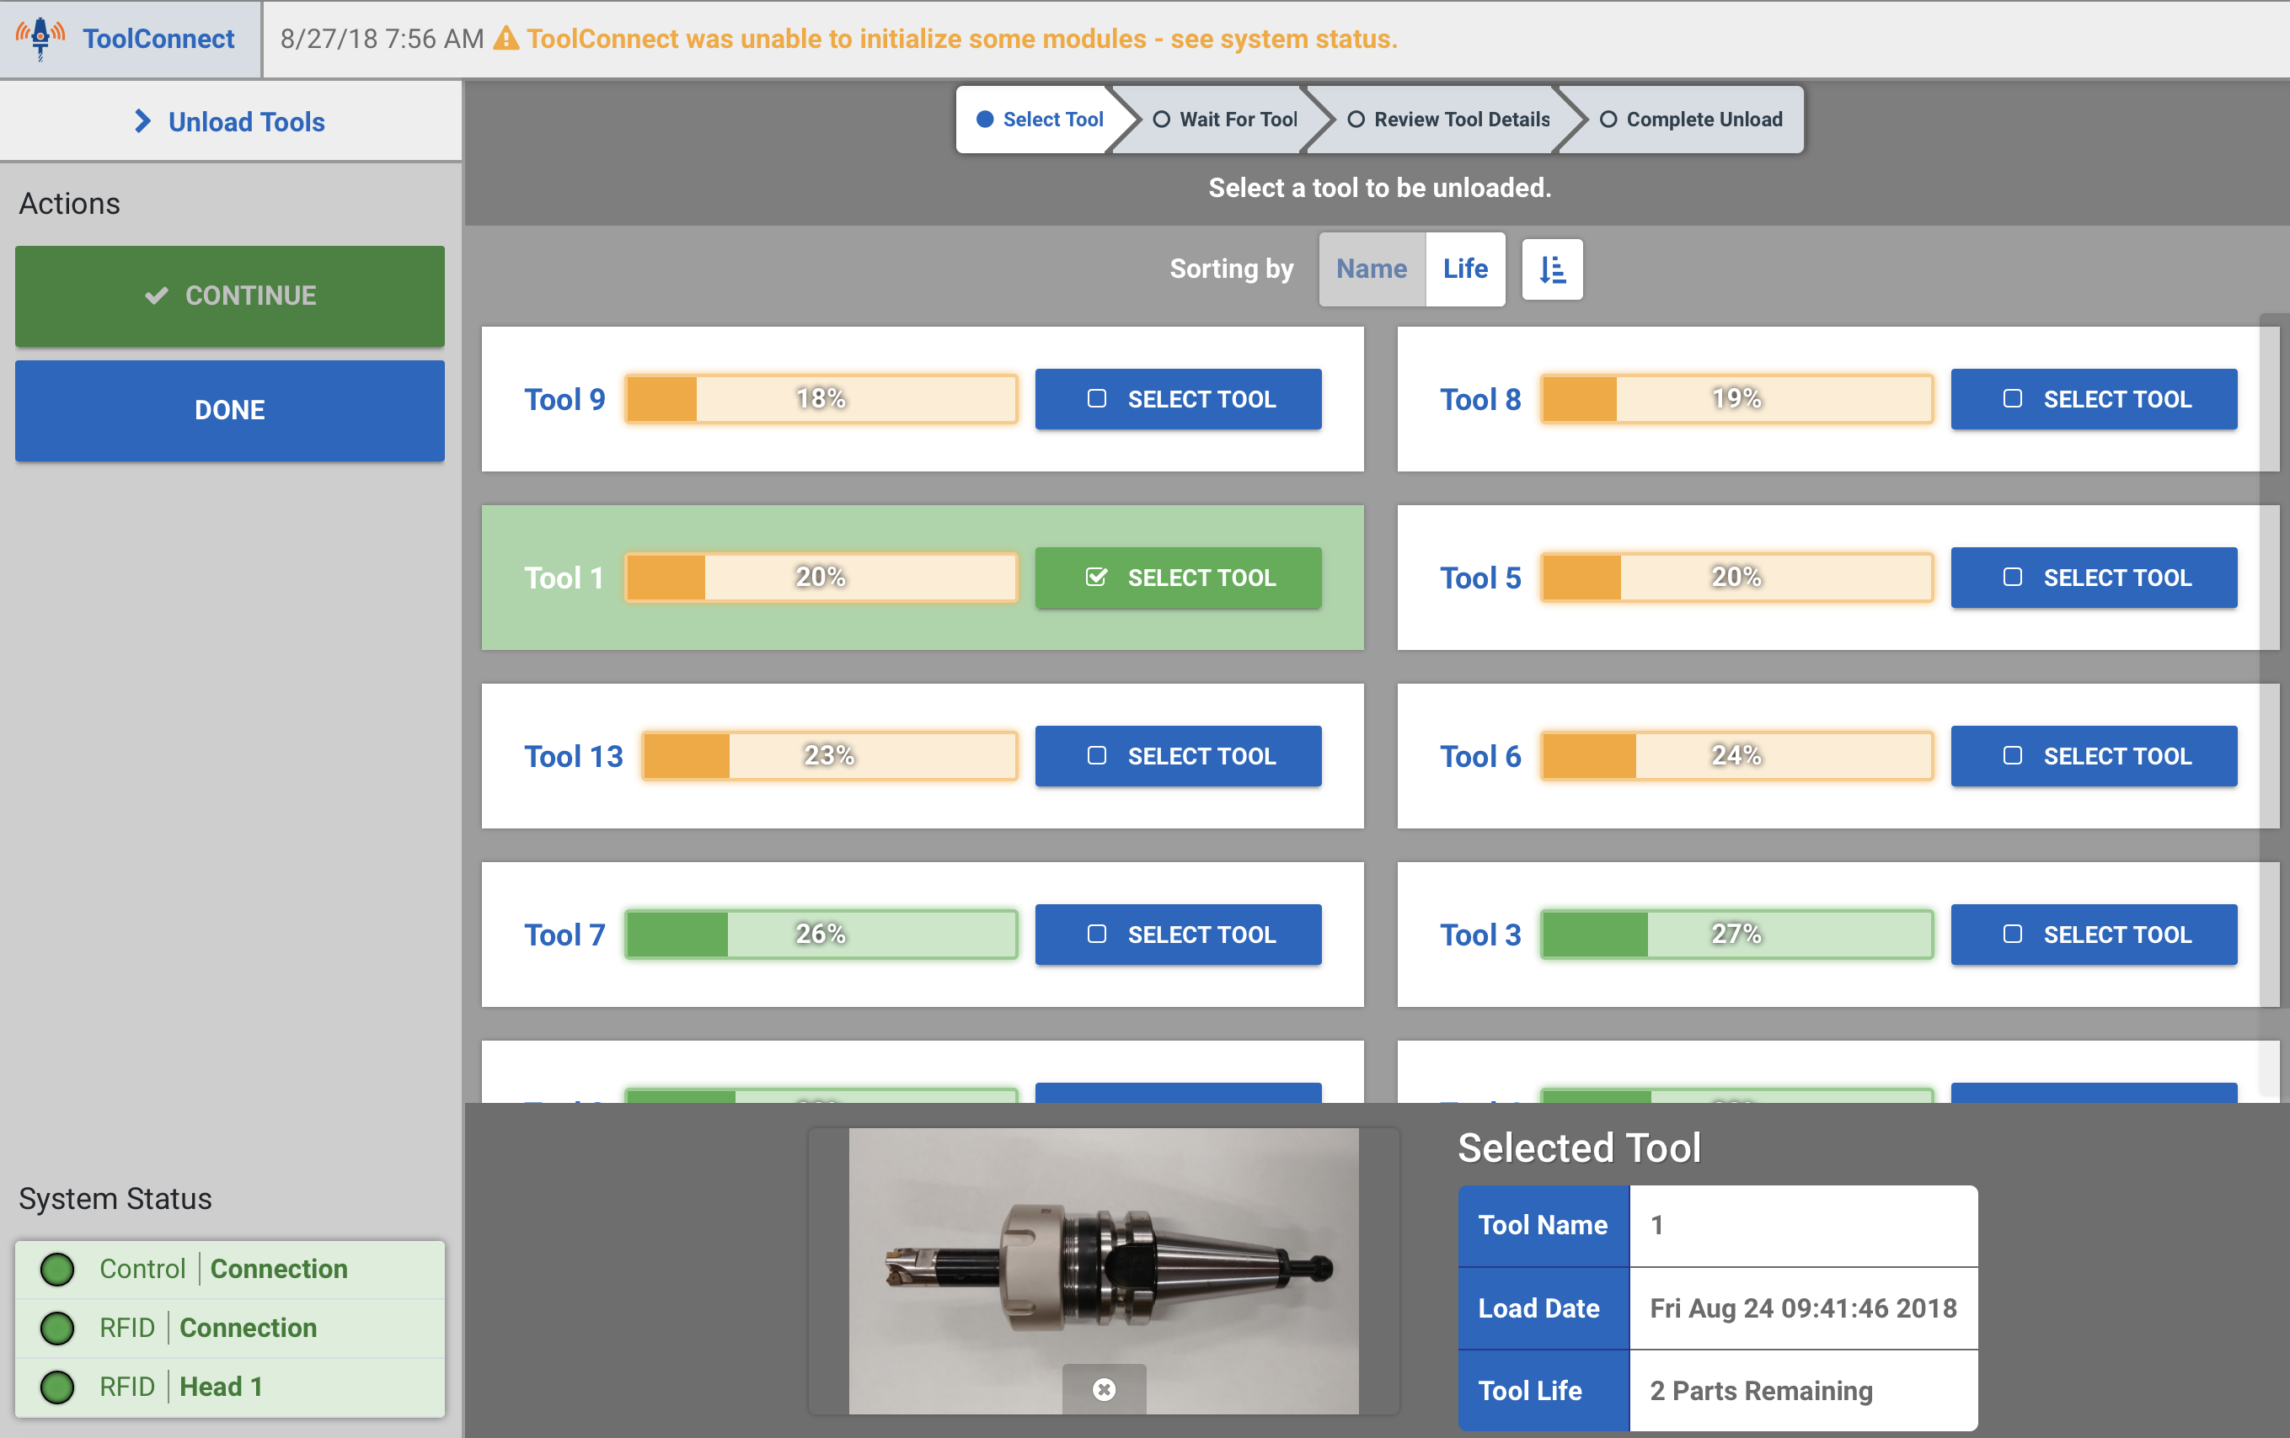
USER INTERFACE ~ Unload Tools
www.caroneng.com

Slide 11
KEY BENEFITS
Automates (off machine) tool measurement
Significantly reduces setup and cycle times
Eliminates operator data entry errors
Automates and confirms the flow of tool loading to optimize productivity
Eliminates the need for a post-processor
www.caroneng.com

Slide 12
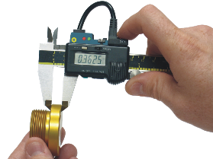
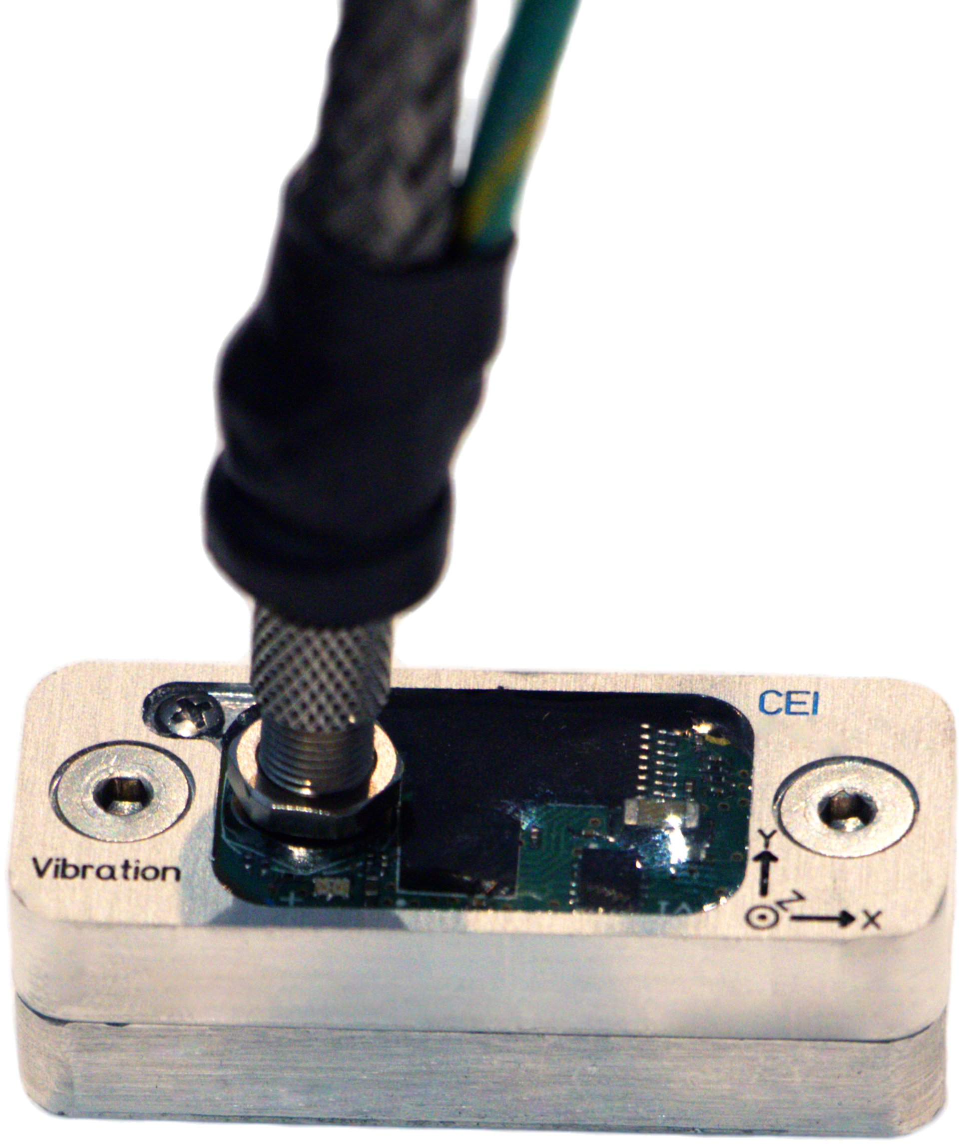
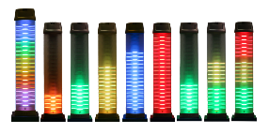
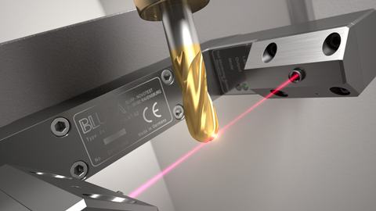
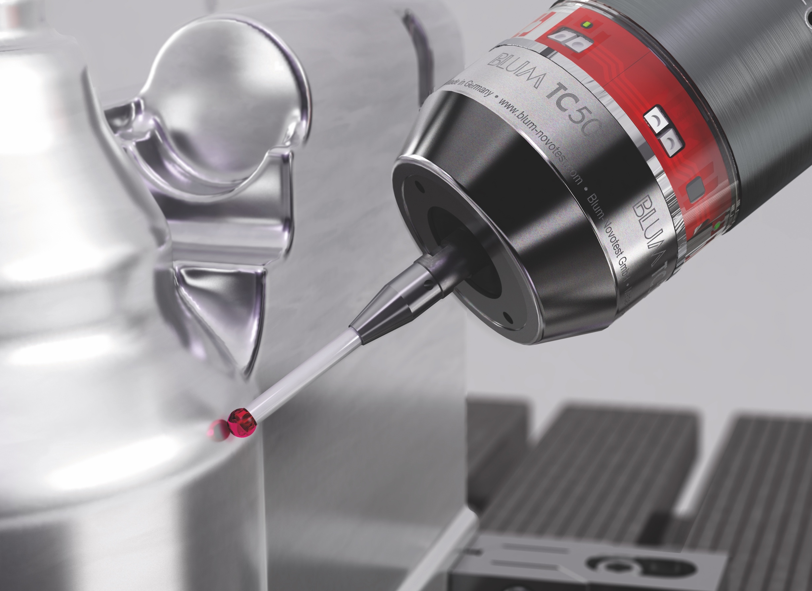
We offer a full product suite of solutions for total machine condition monitoring, optimization, and control.
Reduce cycle time and
maximize tool life with
Tool Monitoring Adaptive Control
Eliminate operator data entry errors with automatic tool wear compensation software
Automatically transfer tool presetter data from RFID tags in tool holders to the machine control
Monitor any area of concern on your CNC machine tool or fixture
Replace your existing status light. 1000 available modes and programmable audible alarm
In addition, we specialize in the integration of…
Laser Systems
for tool setting &
tool breakage detection
Machine Tool
Probing
www.caroneng.com

